Slide 1

Guarding Our Cloud: Symmetric Encryption and Access Control for Untrusted Clouds
by
G. Ajay Kishore
Roll No. 204G1A0506
M. Mounika
Roll No. 204G1A0561
T. Harsha Sri
Roll No. 204G1A0536
B. Bhavana
Roll No. 204G1A0522
Under the guidance of
Mr. M. Narasimhulu M.Tech (Ph.D)
Assistant Professor
Department of Computer Science and Engineering
Srinivasa Ramanujan Institute of Technology
(Autonomous)
2023 - 2024

Slide 2

Contents
Review-0 comments
Abstract
Problem statement
Objectives of Project
Literature survey for first objective
Objective-1 (Design & Implementation)
Literature survey for second objective
Proposed Work
References
GitHub Link
Queries

Slide 3
Review-0 Comments
Team must have better idea on literature survey
Should have a good knowledge on Algorithms

Slide 4
Abstract
Cloud Computing has revolutionized the way data is stored and accessed, offering unparalleled convenience and scalability. However, as organizations increasingly rely on cloud services, concerns about data security and privacy in untrusted cloud environments have become paramount.
So, this project approach is to address these concerns, focusing on access control for symmetrically encrypted data stored in untrusted clouds by combining symmetric encryption techniques with fine-grained access control policies, ensuring data remains confidential even when stored in untrusted cloud environments. The project presents a comprehensive framework that allows data owners to define access policies, specifying who can access what parts of encrypted data, and under what conditions.
Keywords: Encryption, Access Policies, Scalability.

Slide 5
Problem Statement
The increase of data breaches in cloud computing puts all users at risk of
business problems, highlighting the need to improve security measures.
To mitigate the growing risks of data threats faced by users in cloud
Environment, proactive measures are essential.

Slide 6
Objectives of Project
To engineer an access control system of exceptional robustness, tailored specifically to ensure heightened data security within shared resources residing in potentially untrusted cloud environments
To implement the access control scheme and addressing the problem of revocation by using cryptographic techniques.

Slide 7
Literature survey for First objective
[1] In this paper, The proposed system says that the categorized searchable encryption algorithm develops the different structures that are deployed on which security and efficiency rely. By using this algorithm, we will be encrypting the particular block of Data so that only particular data will be encrypted instead of whole data. Furthermore, hybrid approaches using a combination of primitives can provide more properties securely.

Slide 8
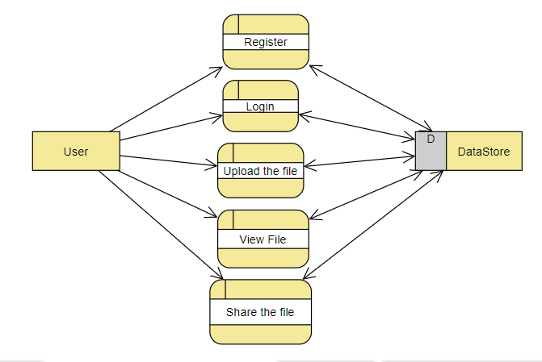
Design and Implementation for first objective

Slide 9
Design and Implementation for first objective
CLASS DIAGRAM

Slide 10
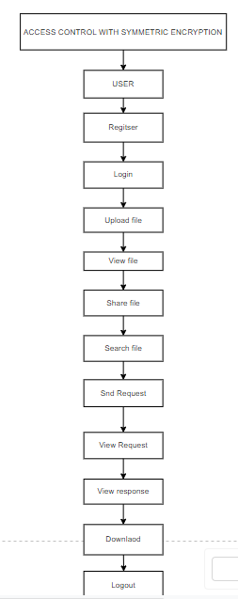
Design and Implementation for first objective
FLOW DIAGRAM

Slide 11
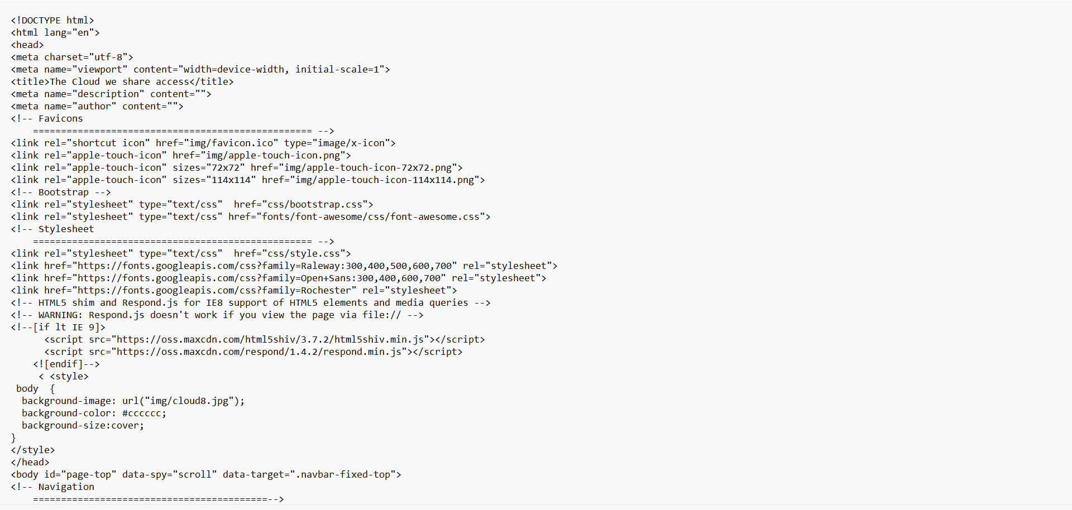
Design and Implementation for first objective

Slide 12
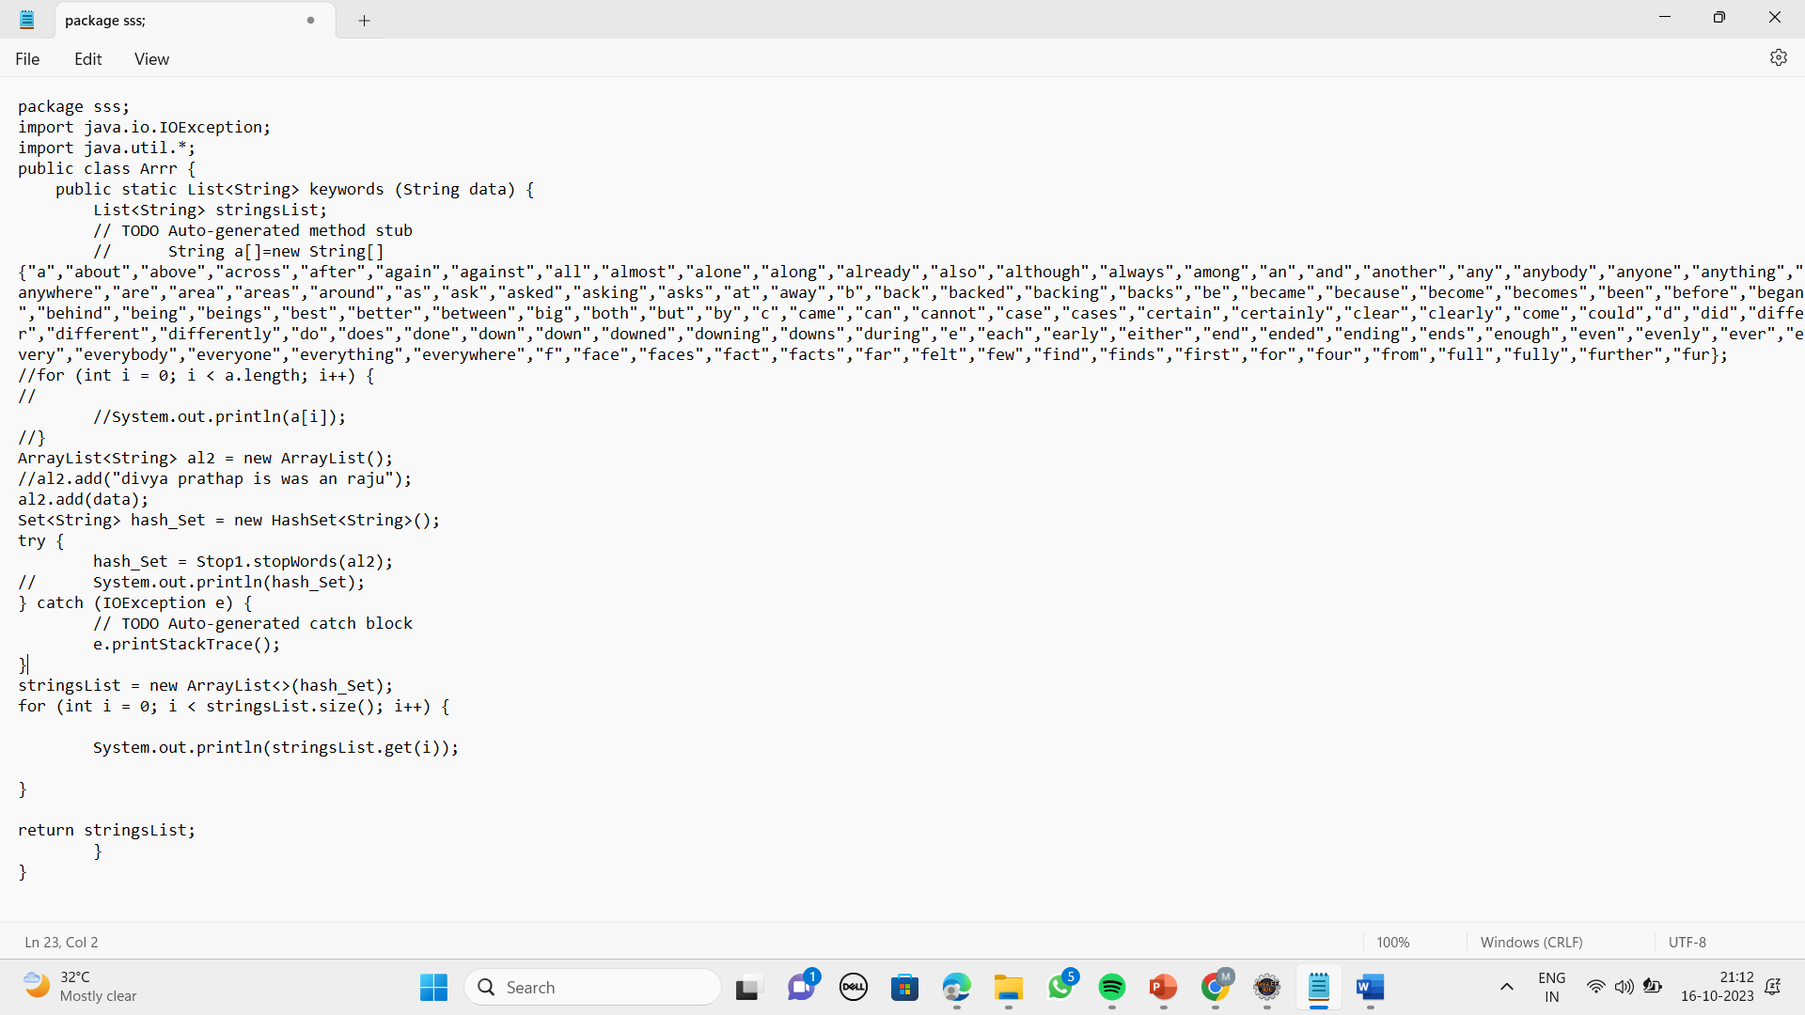
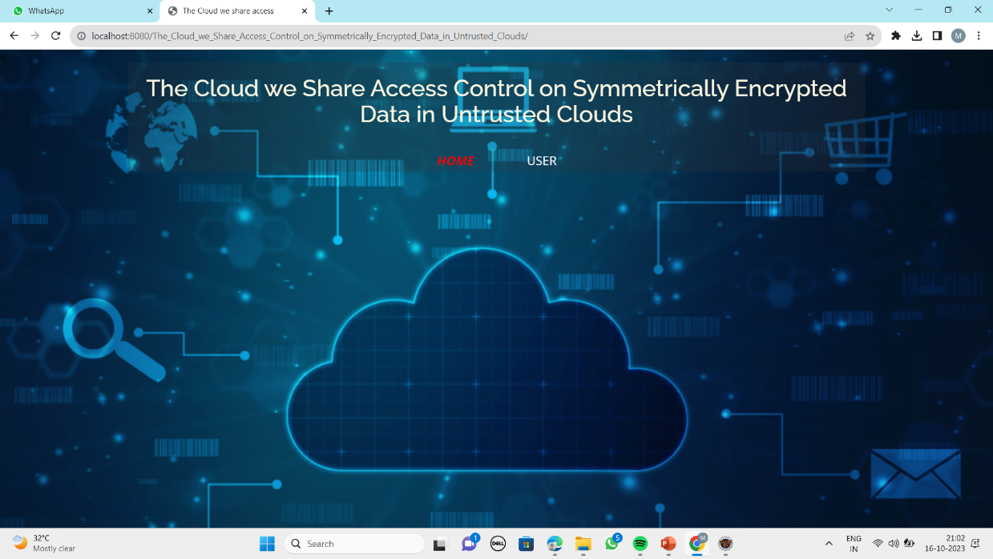
Design and Implementation for first objective

Slide 13
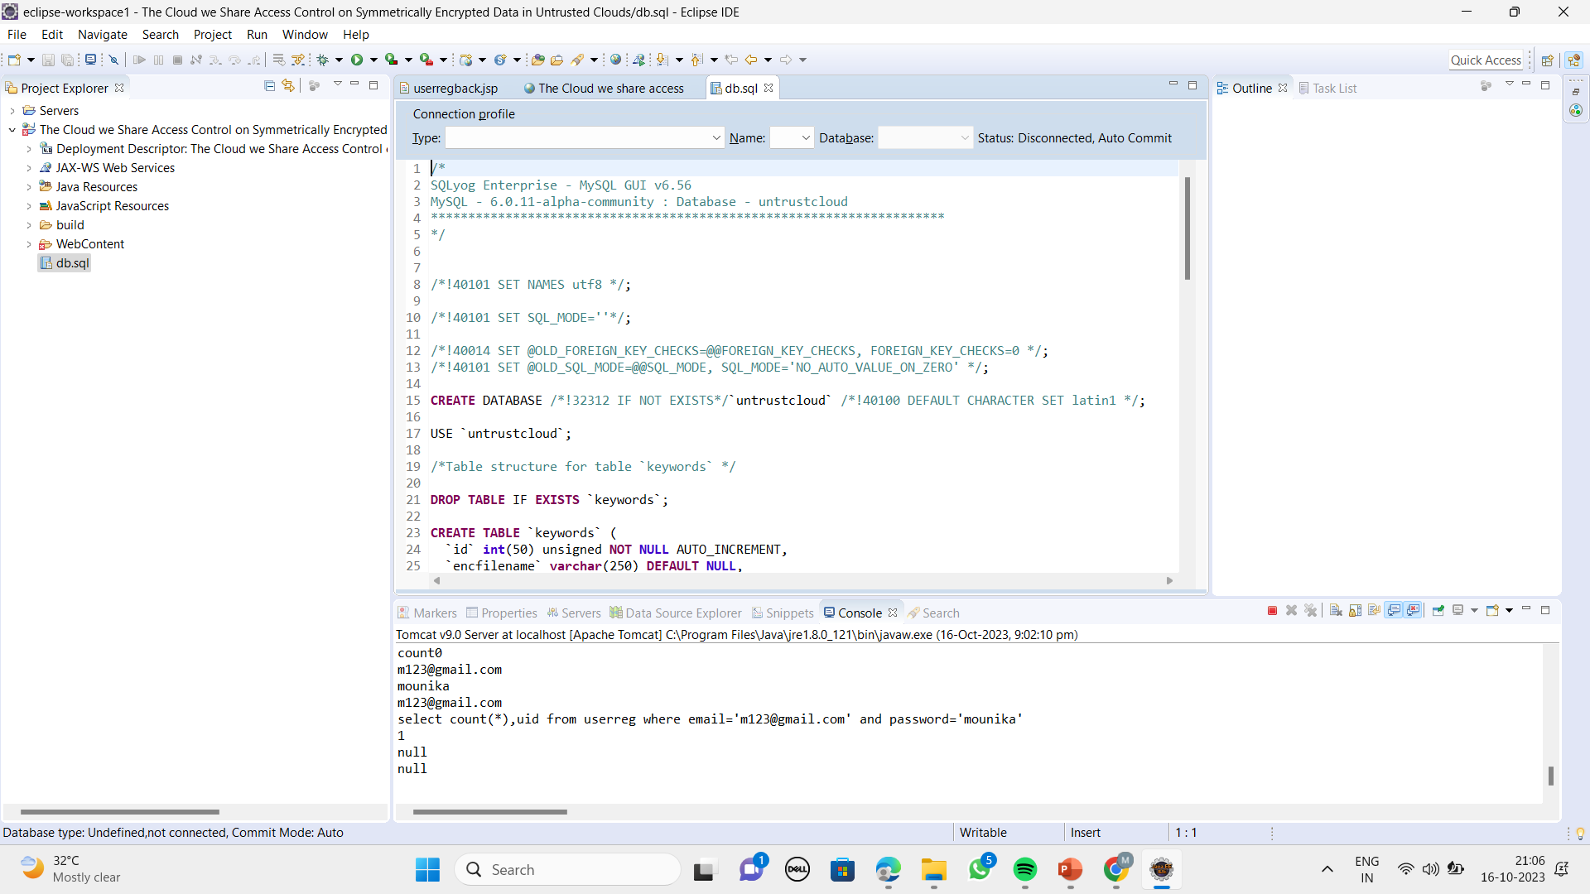
Design and Implementation for first objective

Slide 14
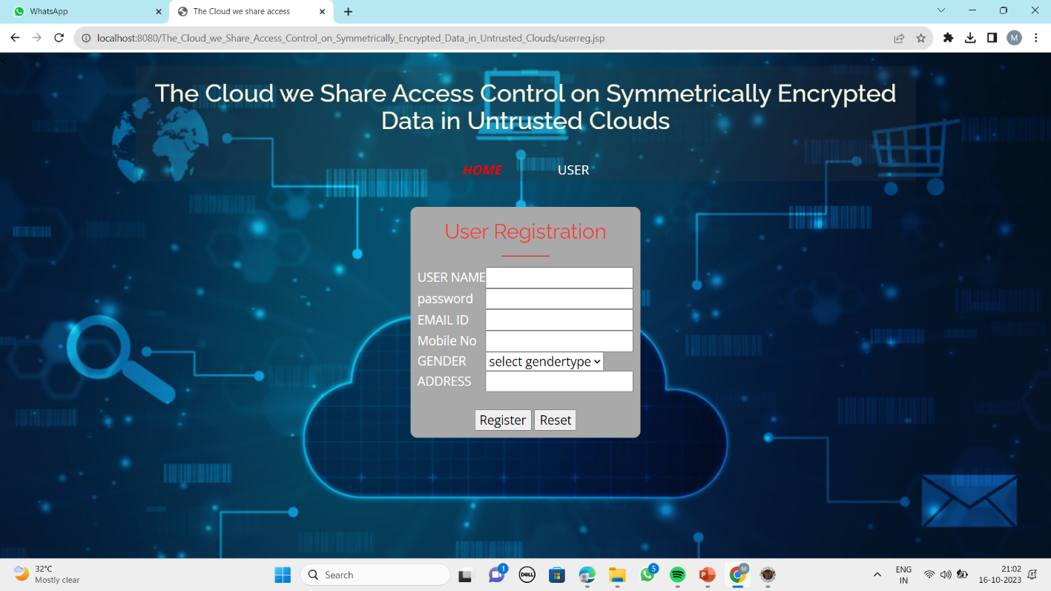
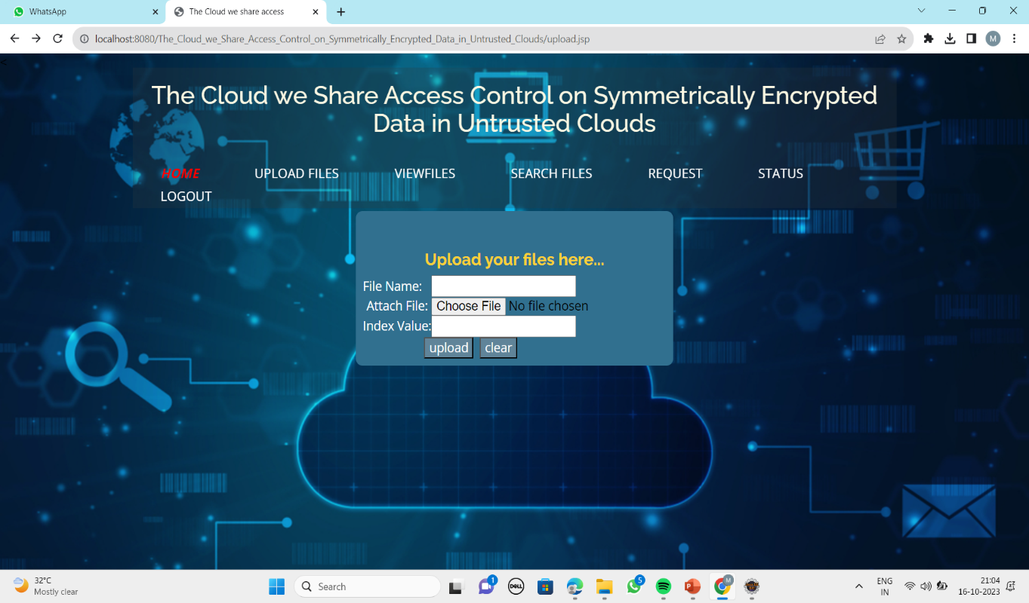
Design and Implementation for first objective

Slide 15
Literature survey for Second objective
[2] In this paper, the system says that In several distributed systems a user should only be able to access data if a user posses a certain set of credentials or attributes. Currently, the only method for enforcing such policies is to employ a trusted server to store the data and mediate access control. However, if any server storing the data is compromised, then the confidentiality of the data will be compromised. In this paper we present a system for realizing complex access control on encrypted data that we call ciphertext-policy attribute-based encryption.

Slide 16
Proposed System
In proposed system, we use these two cryptographic techniques that squarely fit cloud-based environments to design a hybrid encryption scheme based on ABE and SSE in such a way that we utilize the best out of both of them.
The data can be encrypted into cipher text before moving into cloud by using a single key.
The revocation mechanism and an access control one, that are agnostic to the cryptographic primitives used in our construction.

Slide 17
References
[1] Geong Sen Poh, Ji-Jian Chin, Wei-Chuen Yau, Kim-Kwang Raymond Choo, and Moesfa Soeheila Mohamad. 2017. “Searchable symmetric encryption: Designs and challenges”. ACM Comput. Surv. 50, 3, Article 40 (May 2017)
[2] J. Bethencourt, A. Sahai, and B. Waters, ‘‘Ciphertext-policy attribute-based encryption,’’ in Proc. IEEE Symp. Secur. Privacy (SP). Washington, DC, USA: IEEE Computer Society, 2007, pp. 321–334.
[3] A.Bakas and A. Michalas, “The Cloud we Share: Access Control on Symmetrically Encrypted Data in Untrusted Clouds” IEEE Access(Volume 8), 2020.

Slide 18
References
[4] A. Boldyreva, V. Goyal, and V. Kumar, ‘‘Identity-based encryption with efficient revocation,’’ in Proc. 15th ACM Conf. Comput. Commun. Secur. (CCS), New York, NY, USA, 2008, pp. 417–426.
[5] J. Bethencourt, A. Sahai, and B. Waters, ‘‘Ciphertext-policy attribute-based encryption,’’ in Proc. IEEE Symp. Secur. Privacy (SP). Washington, DC, USA: IEEE Computer Society, 2007, pp. 321–334.

Slide 19
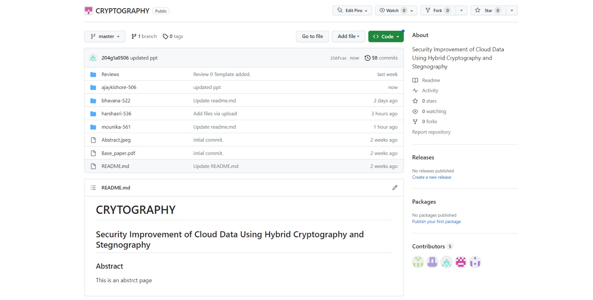
Git Hub Dashboards of each student
https://github.com/SRIT-CSE/CRYPTOGRAPHY.git

Slide 20
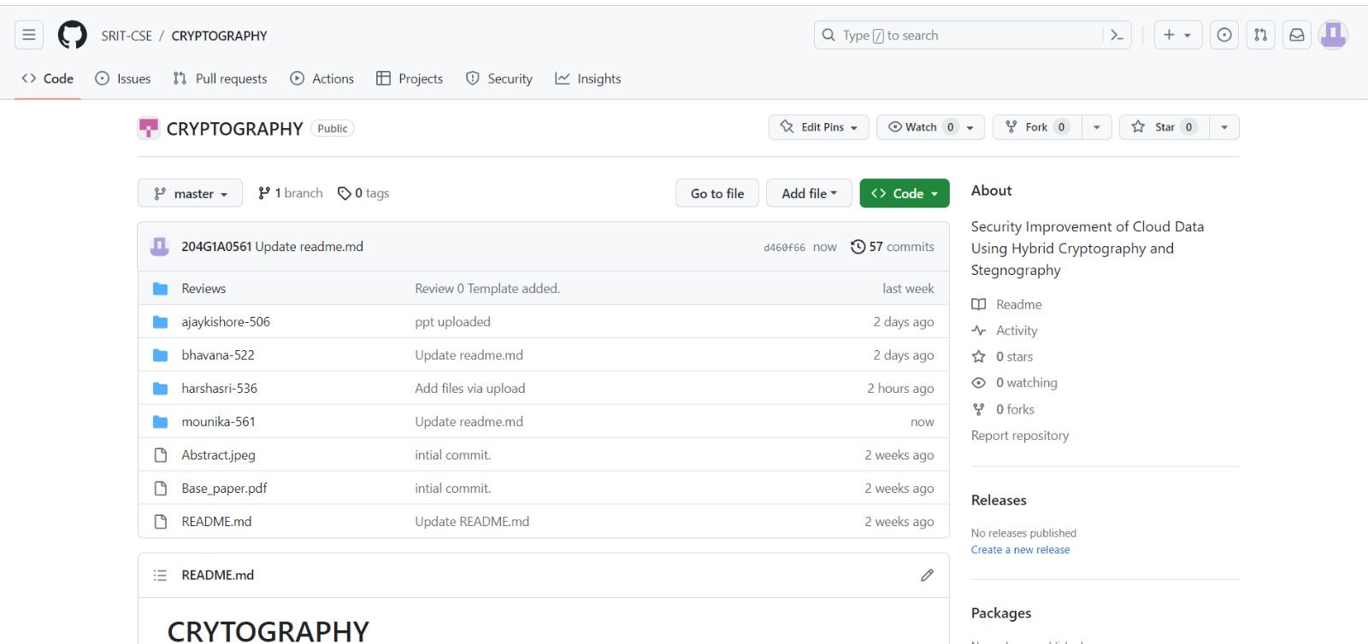
Git Hub Dashboards of each student
https://github.com/SRIT-CSE/CRYPTOGRAPHY.git

Slide 21
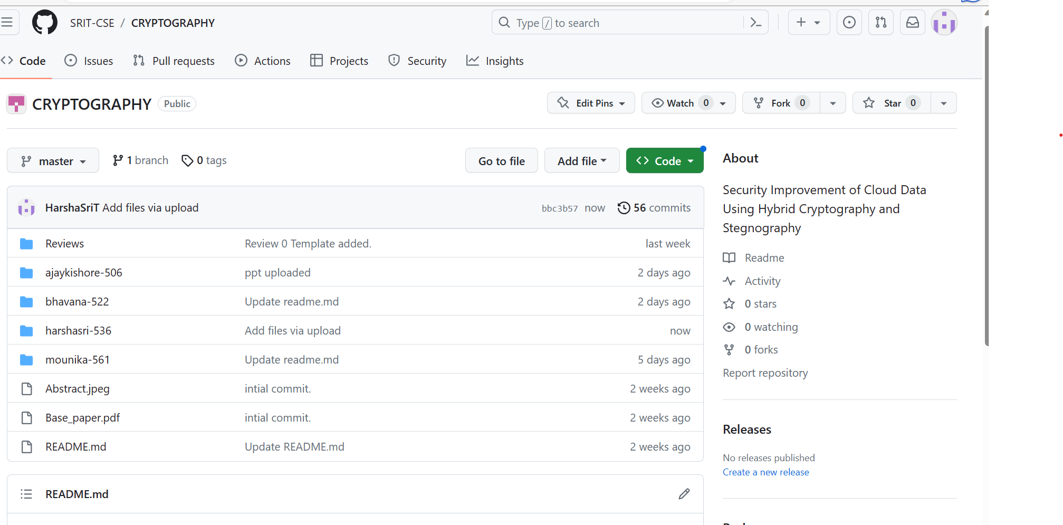
Git Hub Dashboards of each student
https://github.com/SRIT-CSE/CRYPTOGRAPHY.git

Slide 22
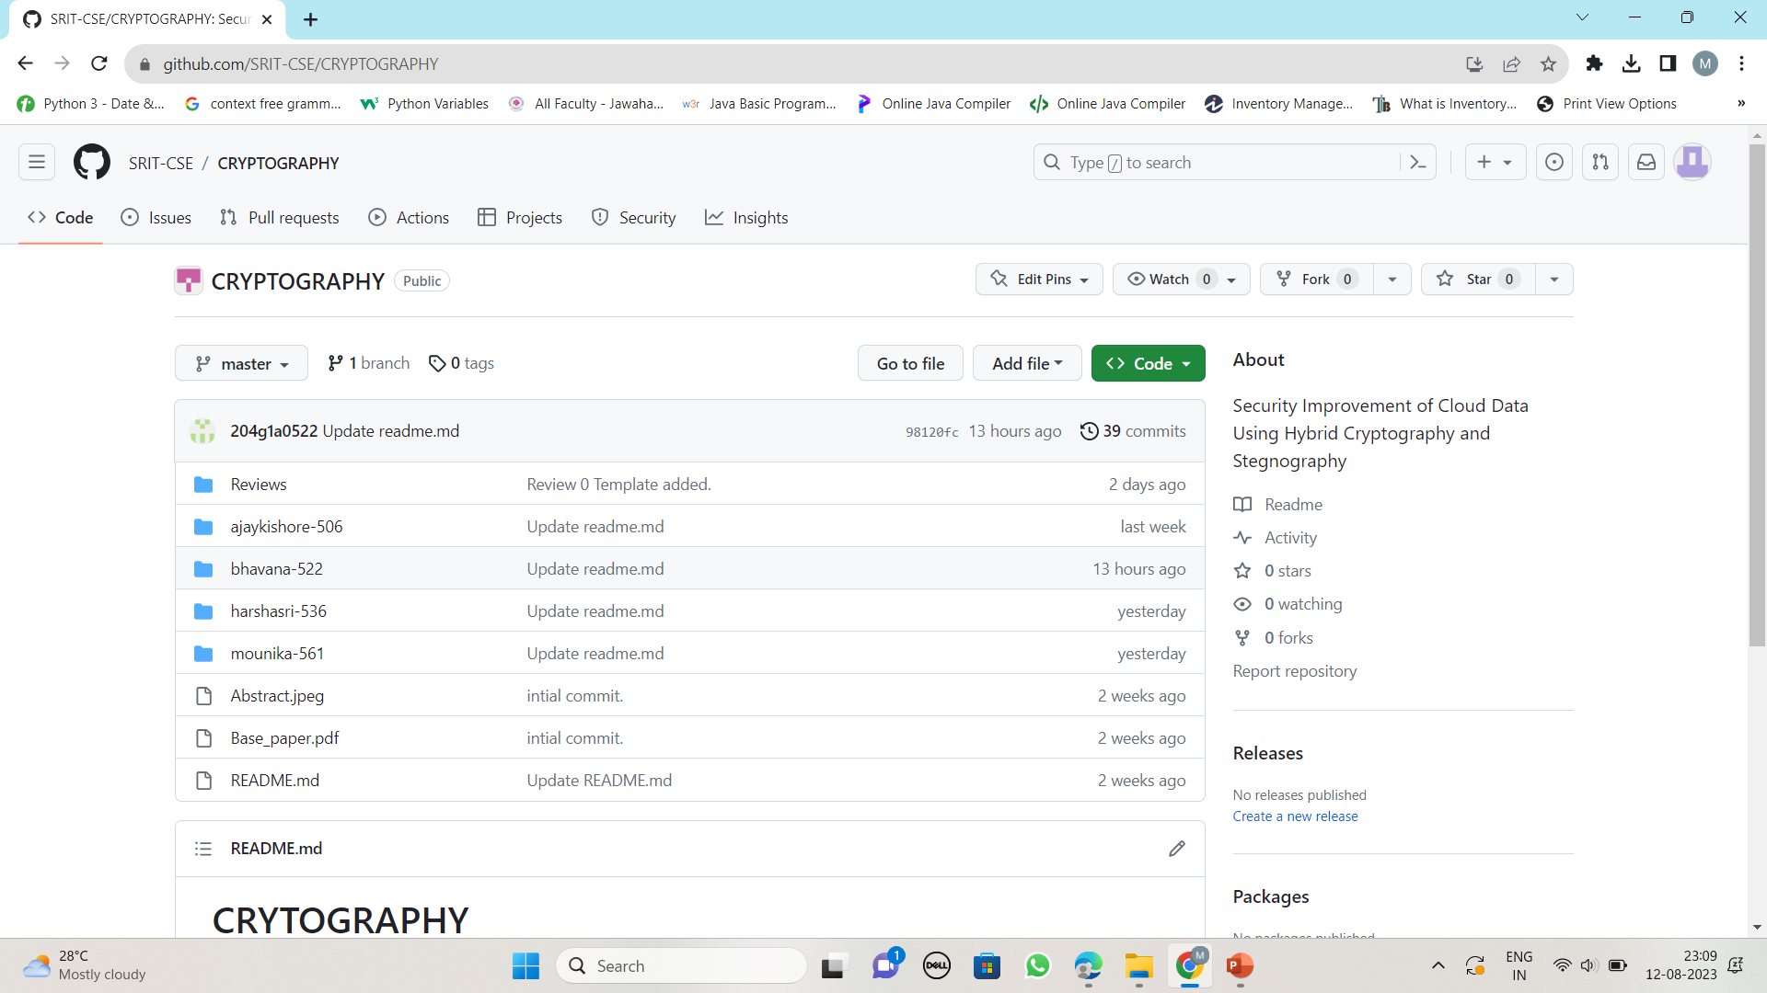
Git Hub Dashboards of each student
https://github.com/SRIT-CSE/CRYPTOGRAPHY.git

Slide 23
Any Queries?

